Slide 1
Android.Media
Playing Audio and Video
Javed Ahmed Imtiaz

Slide 2
Android.Media
Audio & video playback
Audio & video recording
Camera API

Slide 3
MediaPlayer & DataSource
The MediaPlayer class can be used to control the playback of audio/video files and streams
Creating a new MediaPlayer Object
MediaPlayer mp = new MediaPlayer();
Setting the data source for the MediaPlayer object
mp.setDataSource(path);
The data source can be a URL or a local SD Card path on the Android phone. The Mp3 format works for audio and the video formats supported are 3gpp and Mp4.

Slide 4
Preparing the MediaPlayer
Preparing the MediaPlayer for playback
mp.prepare();
Prepares the MediaPlayer for synchronous playback
Alternative
mp.prepareAsync();
Prepares the MediaPlayer for asynchronous playback

Slide 5
Starting and stopping playback
Starting playback
mp.start();
The start() method begins playing the file or resumes playback from the paused state.
Stopping playback
mp.stop();

Slide 6
Seeking and pausing
Seeking
mp.seekTo(int msec);
The seekTo() method can be used to rewind or fast-forward the file being played.
Pausing playback
mp.pause();

Slide 7
Setting looping on/off
mp.setLooping(boolean looping)
You can set the video or audio to be played to stop after playing once by setting mp.setLooping(false) or to repeat by setting mp.setLooping(true).

Slide 8
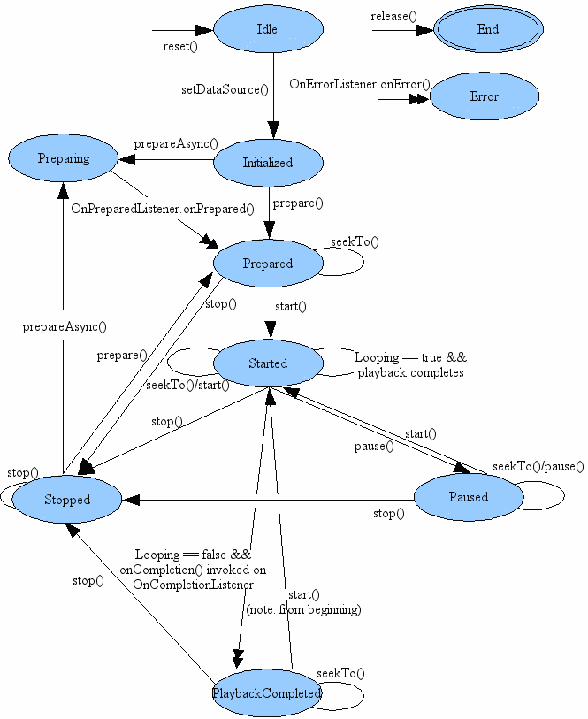
Android.Media: MediaPlayer States

Slide 9
Setting the MediaPlayer volume
mp.setVolume(float leftVolume, float rightVolume);
This sets the MediaPlayer’s volume level for the left and right speakers.

Slide 10
Getting the duration and current position
The getDuration() method returns the total duration of the media file in milliseconds
The getCurrentPosition() method returns the current position of the media file in milliseconds

Slide 11
Android.view.SurfaceView
A SurfaceView can be used to display the picture in case of a video file. It is similar to a canvas and provides a dedicated drawing surface embedded inside of a view hierarchy. You can control the format and size of this surface and the SurfaceView will take care of the placement of the surface at the correct location on the screen.
Access to the underlying surface is provided via the SurfaceHolder interface, which can be retrieved by calling getHolder().

Slide 12
Video height and width
If you want to specify the height and width of the SurfaceView, you can use the methods
getVideoHeight()
and
getVideoWidth()
Once the data source has been set for the MediaPlayer

Slide 13
Disadvantage of using the Android emulator for MediaPlayer testing
The Android emulator’s ability to handle video playback is very limited.
Video stored locally on the emulator may play, but it will have a very slow framerate
Streaming video may not play at all on the emulator
It is recommended to test video playback on an actual android device

Slide 14
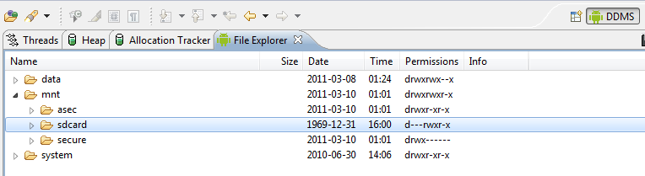
Pushing a media file onto the Emulator SD Card
DDMS in Eclipse can be used to upload audio or video files onto the emulator’s SD card.

Slide 15
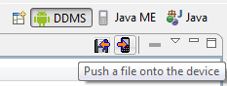
Pushing a media file onto the Emulator SD Card
After selecting /mnt/sdcard/, click on the button under DDMS showing a phone with an arrow. The file can be accessed in your program using the path:
/mnt/sdcard/<filename>

Slide 16
Lab Exercise
Modify the MediaPlayerDemo_Audio.java and MediaPlayerDemo_Video.java files in the APIDemos Android sample project. The objective is to be able to play audio and video files from a local SD card as well as from a video stream.
These files are located in the com.example.android.apis.media package in the APIDemos sample.

